Slide 1
Project ESG
Data Diligence
Notes:
I would like to congratulate my colleagues at ECA for their excellent presentation!
Thank you to Virtu Financial and Inclusionsion Bridge for this opportunity
Opportunity…

Slide 2


MEET OUR TEAM
TYLER MILLS
Undergraduate Senior
AALIYAH LOCKETT
Undergraduate Junior
Notes:
REALLY!

Slide 3
Problem Statement
Is there any sort of relationship between the ESG score and ACE?
Is there a specific ESG component that is more correlated with ACE?
How does the ESG score relate to other trading analytic metrics including volatility, spread and liquidity?
Would we recommend the purchase of ESG data in order to increase the accuracy of the ACE model?
Notes:
in order to increase the accuracy of the ACE model?

Slide 4
Conclusion
We found no relationship between the ESG score and ACE
We found that there is no ESG component that has a direct correlation with ACE model output
Controversy is related to the trading metrics of spread and liquidity
We would not recommend you purchase the ESG data without further analysis

Slide 5
Data Dictionary
Security Grouping | Company’s Ticker S&P or non S&P
Total ESG Score Environment Social Governance Controversy | Total ESG Score Environment Social Governance Controversy | High score means High Risk Components of Total ESG Public perception of how a company manages controversy and incidents
21 day median daily value 5 day time weighted spread 60-Day Standard Deviation of Daily Returns | Liquidity Spread Volatility | Trading Metrics - input ACE Model
Estimated price impact for 1% MDV Estimated price impact for 5% MDV Estimated price impact for 25% MDV Estimated price impact for 50% MDV Estimated price impact for 100% MDV | Est 1% Est 5% Est 25% Est 50% Est 100% | Estimated Price impact - output from ACE Model
Notes:
We have the same data dictionary as our colleagues at ECA, we just have the outputs called EST 1% to 100%

Slide 6
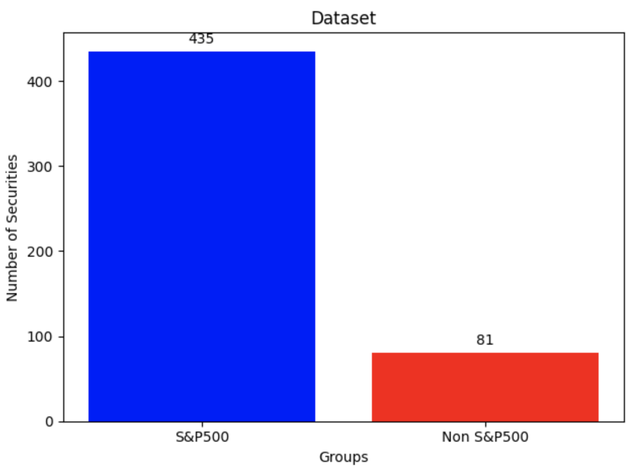
Exploratory Data Analysis
516 rows - one for each Security
2 groupings (S&P and Non-S&P): Non S&P are ESG focus securities
Began our analysis with separating S&P and non S&P
When we investigated further we found no significant differences between the populations
And when we used Stratification we found we did not have enough securities in non S&P Grouping
So we kept the combined data set for further analysis
Notes:
Frst we looked into the distribution of the S&P and the non S&P groups and did not find a significant enough difference between them such that we decided to
use the full dataset throughout our analysis
On the right this s a representation of the relationship between the ACE models in and output which is clearly nonlinear
in order to explore correlations between our in & outputs we determined it would be best to use distance correlation as our main statistic as it
takes into account both linear and non linear relationships
whereas traditional correlation measures, like Pearson's correlation, are only sensitive to linear relationships.

Slide 7
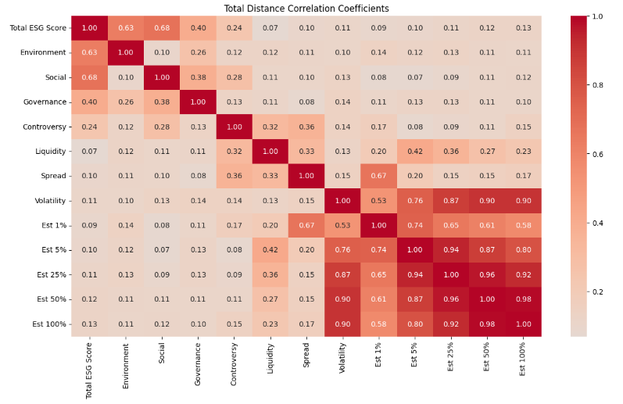
Exploratory Data Analysis
We used distance correlation that goes from 0 to 1 as it returns the absolute distance. It captures both linear and non-linear dependencies between variables
Notes:
Here we have a pairwise heatmap showing the first order correlation between the ESG scores + their components as well as the ACE Model inputs and outputs
The blue highlight is looking at this particular relationship and shows a Strong relationship between trading metrics and ACE output.
as you can see the correlation for Spread is high at 1% with .67 , then after 5% Volatility takes over, and Liquidity at 5% has some relation as well
We already know explicitly that Distance correlation is always positive because it gives the absolute difference

Slide 8
Exploratory Data Analysis
Notes:
Here we are looking at the relationship between total ESG score as well as the components and the ACE model output and we found No evidence of relationship between them

Slide 9
Exploratory Data Analysis
Notes:
Here we are looking closer at the controversy score with the trading metrics( spread and Liquidity) but we see no relationship with the ACE output
You will see more later in the presentation that we further explore the relationship between controversy and spread/liquidity .

Slide 10
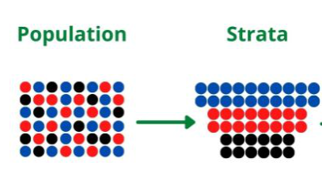
Exploratory Data Analysis
EDA showed no first order effects between ESG and ACE, and other than controversy, showed no first order effects with the trading metrics
So, we needed to perform further analysis
Based on the high correlations we saw, we know there are strong relationships between the trading metrics and ACE
We then explored how these relationships change when we stratify ESG using subsets of the population.
Stratification is when we take a subset of the population with certain characteristics (e.g., high Total ESG score only) to look for changes in strength of relationships
High Total ESG Score
Medium Total ESG Score
Low Total ESG Score
Notes:
first order: direct
Now Anaiya is going to walk you through the details of our methodology to show you how we performed further analysis.

Slide 11
Methodology
Liquidity
Est 1%
Est 5%
Spread
Black Box
Est 25%
Est 50%
Volatility
Est 100%
Notes:
As mentioned by Aaliyah, since EDA shows no first order effects between ESG and ACE, we explored further by using second order effects.
What do I mean by that?
We treat your ACE model as a Black Box and we look into the black box with the inputs of the (trade metrics: Volatility, spread and Liquidity)and the outputs (Estimated price impacts from 1% - 100%) as shown in the slide.

Slide 12
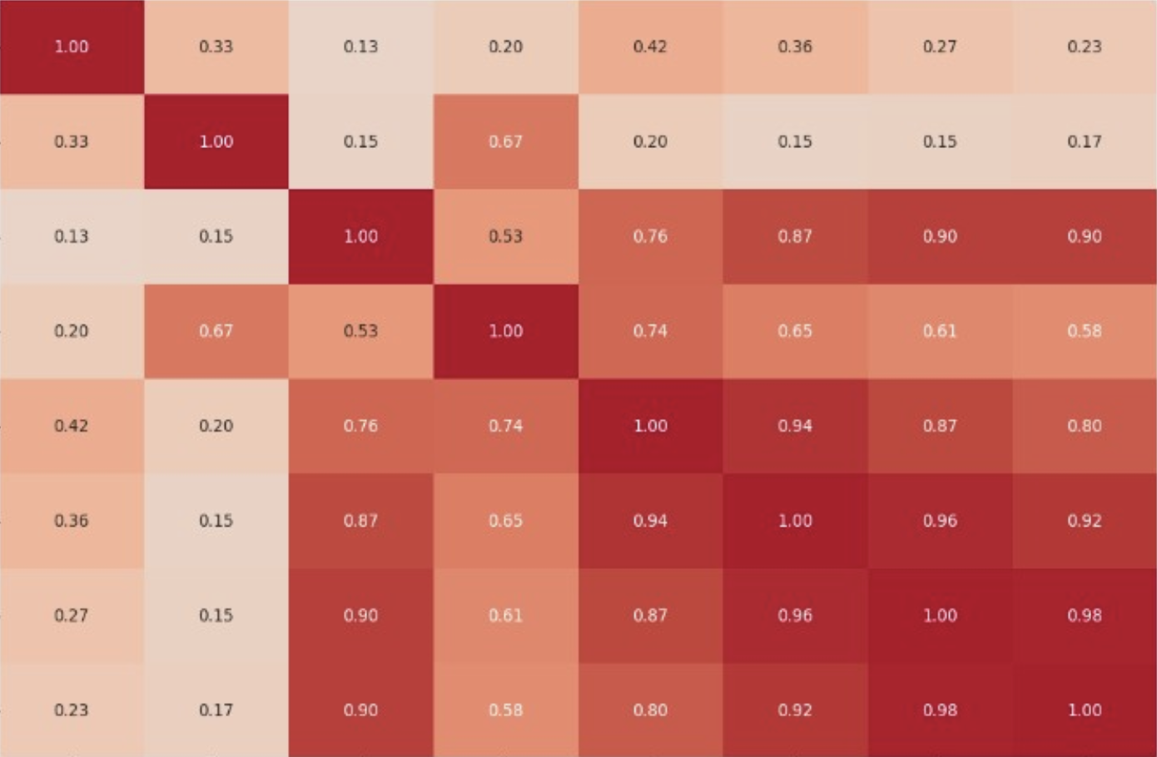
Methodology
“TV Screen” to see inside
Liquidity
Est 1%
Est 5%
Spread
Est 25%
Est 50%
Volatility
Est 100%
Notes:
We can now look and get some visibility into your model by using the known strong correlations between the inputs and the outputs.
We call this the TV Screen.

Slide 13
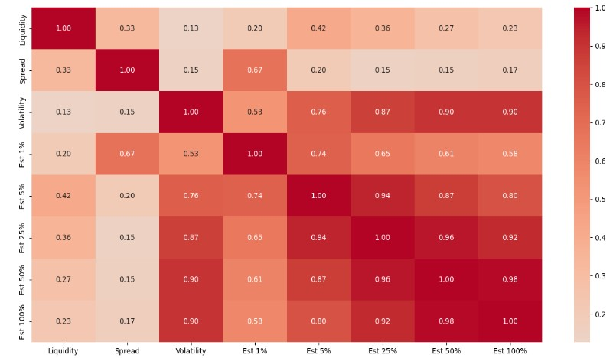
Methodology
Zoom in on “TV Screen”
Notes:
When we zoom in to our TV screen: We can see the most important correlations, i.e. the strongest relationships, highlighted in purple.
These are the same relationships that you told us, were important to your ACE model.
EST1% shows high correlation to spread- 0.67, which means spread is important to the model at 1%
We see Volatility takes over its importance from 5% to 100% ( the increase from 0.76 to 0.90)
You see some correlation in Liquidity at 5% and 25% but its not as strong as the others two

Slide 14

Methodology
Stratification
All Securities
Notes:
Remembering Stratification as explained before: This slide shows the entire population going through the model.
The TV screen is the same as shown before.

Slide 15

Methodology
Stratification
Δ
The “TV Screen” changes
Securities Stratified on High ESG
Notes:
Now, that we stratify. We pass through the model only those securities with certain characteristics, for example high ESG score.
The TV screen changes showing a change in the relationships. We see the correlations changes.That is denoted here as Delta
This change in correlation is a second order effect i.e. How stratifying ESG indirectly changes the direct relationship between input and the output.
Now I am going to use an example to illustrate this.

Slide 16
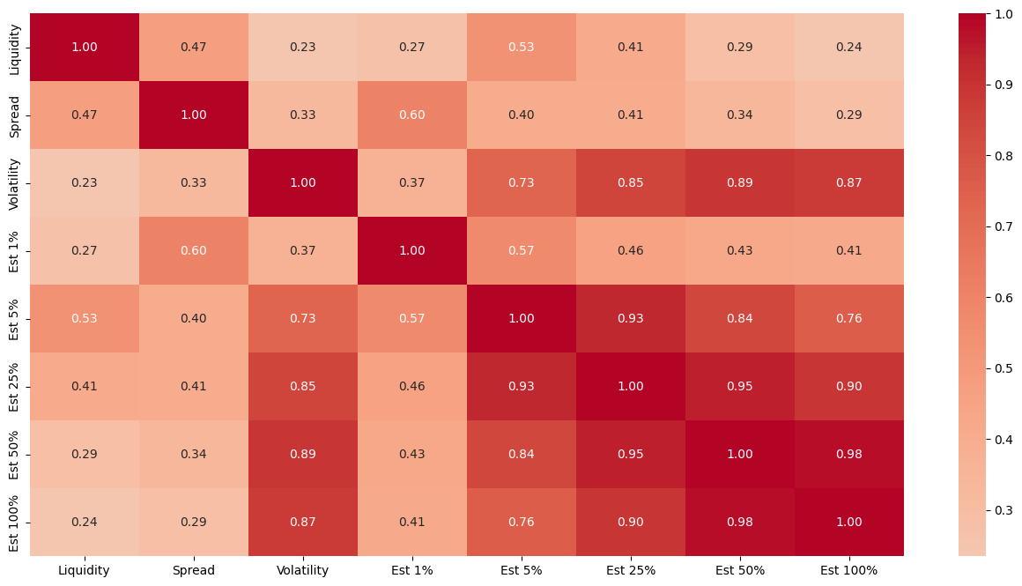
Findings - Example
High Total ESG
Total ESG
Low Total ESG strata = 0 - 20
High Total ESG strata = 30-50
Notes:
We stratified securities using the Total ESG score where low = 0-20, high=30-50
On the right is the population of total ESG showing the baseline relationship
and On the left is only those companies with high ESG scores, showing the Delta.
The purple highlight here shows the strong relationship in your model- Spread to 1% it is 0.67 and it changes when stratified with High ESG only to 0.60
The green shows the second order effect of our findings that is the change in correlation from 0.15 (in total ESG) to 0.41 on the (high strata)
We Tried to Eyeball them all???? Couldn't easily find the biggest changes, So we wrote a biggest difference program

Slide 17
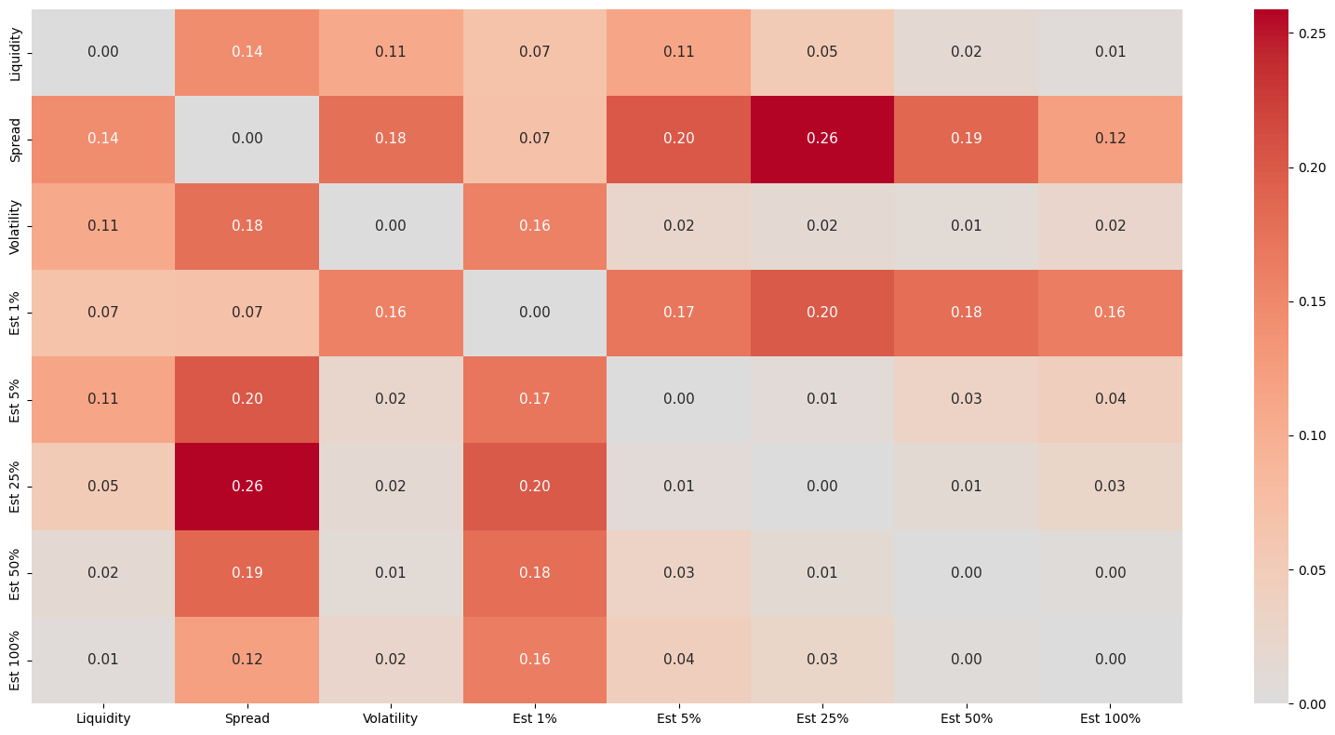
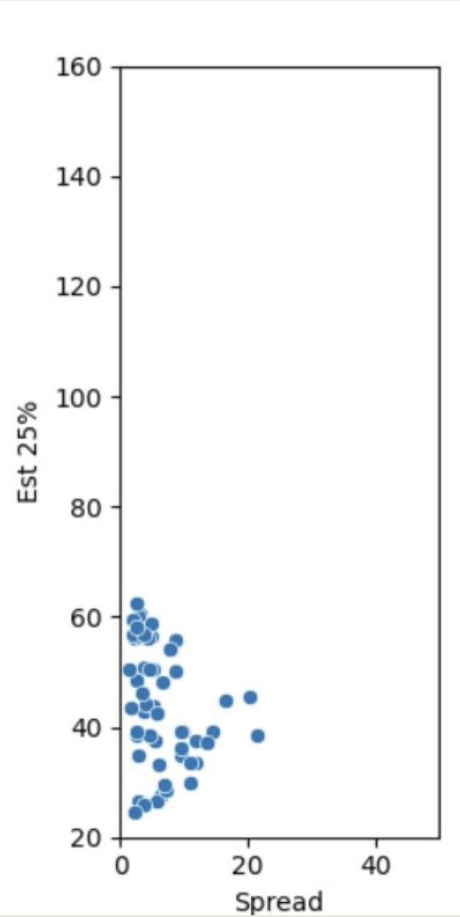
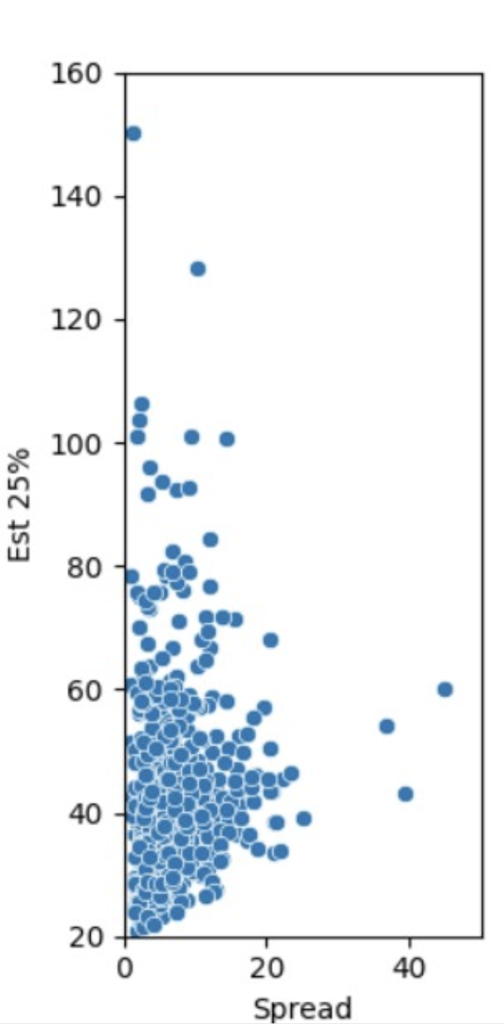
Findings - Example
Scatter Plot Validation
Biggest Difference
High ESG Score
N = 55, corr = 0.41
p = 0.0
Total ESG Score
N= 516, corr = 0.15
p=0.0398
Notes:
On the left we see Output of our biggest difference program and it confirms the biggest difference is at 25% that is 0.26
And Because of this delta, when we wanted to dig deeper and compare between the scatter plots on right between Spread and Output at 25%
The high strata scatter looks like a subset of the total ESG scatter and the correlation increases when we take only the high ESG strata
But, because spread at 25% is not important to the ACE Model, that's why we walked away from it, Had it been spread at 1% this would have been a nugget.
With that, I would like to hand over to Quinn to share the ESG component findings.

Slide 18
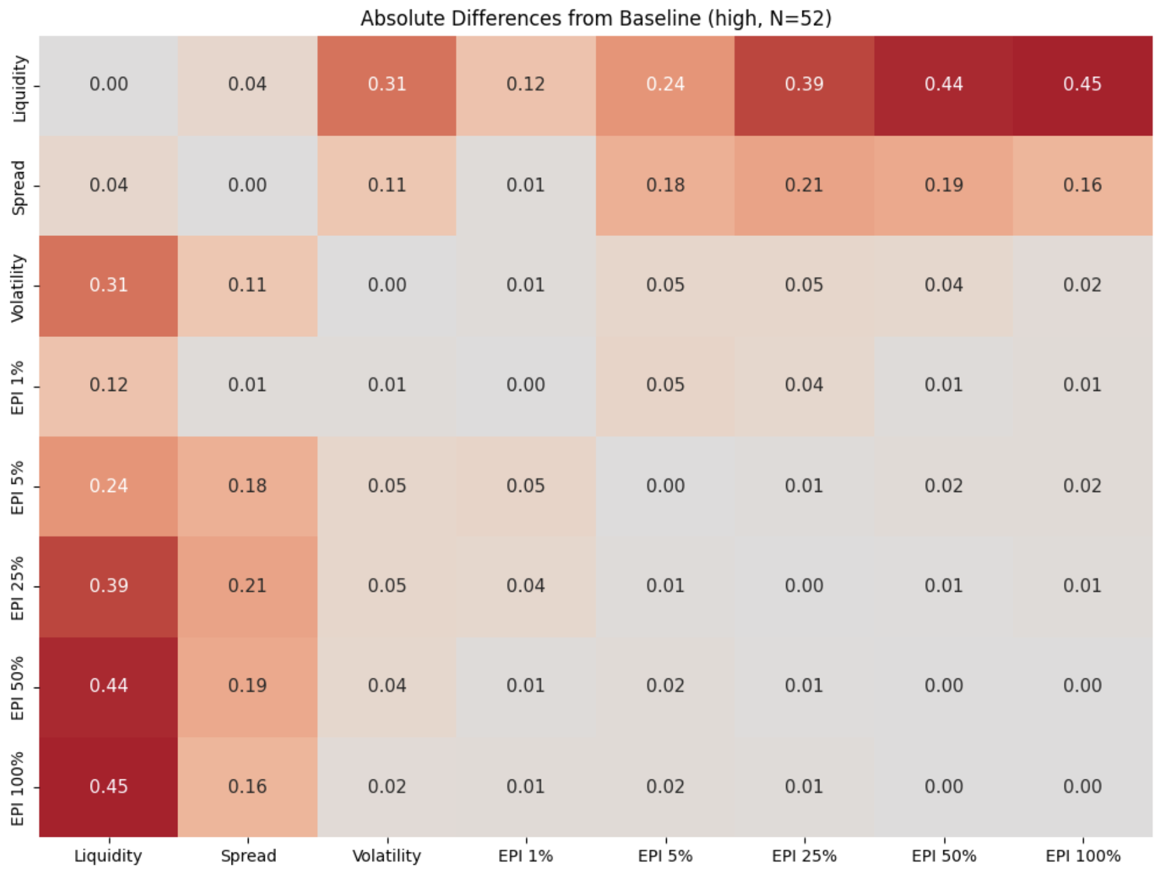
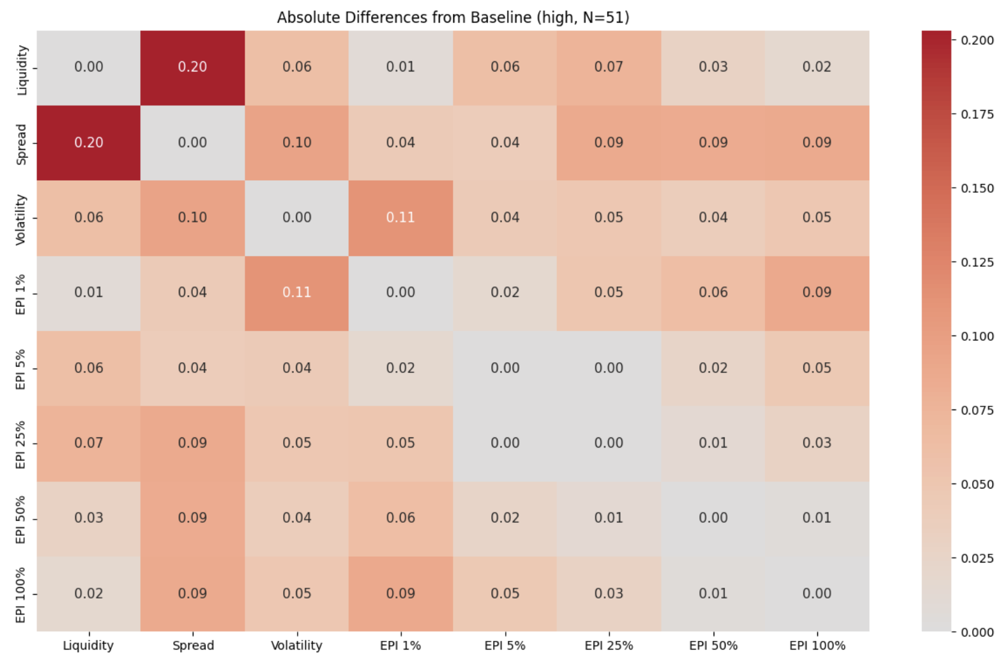
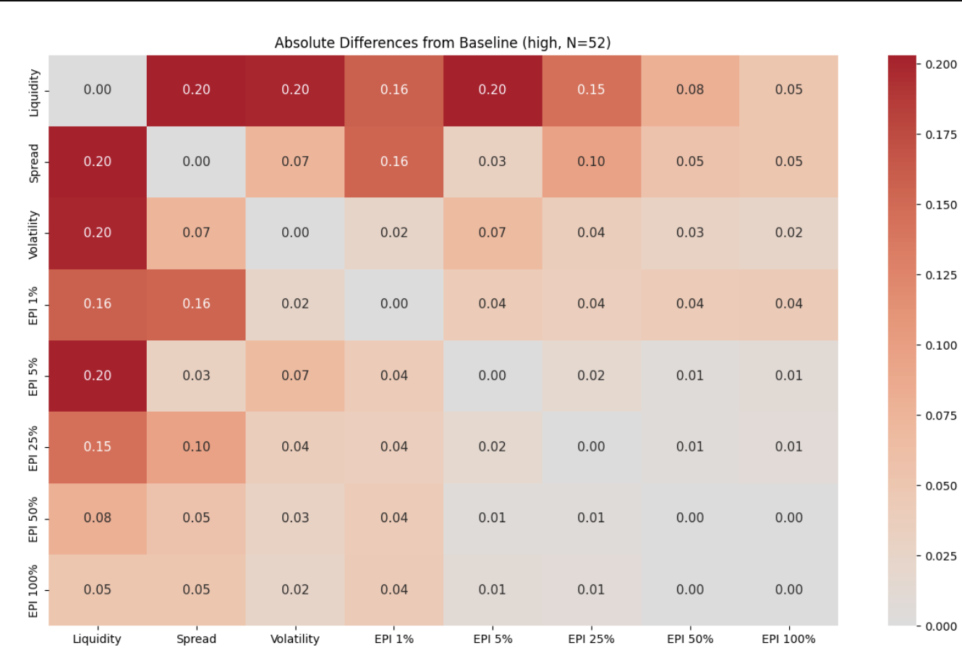
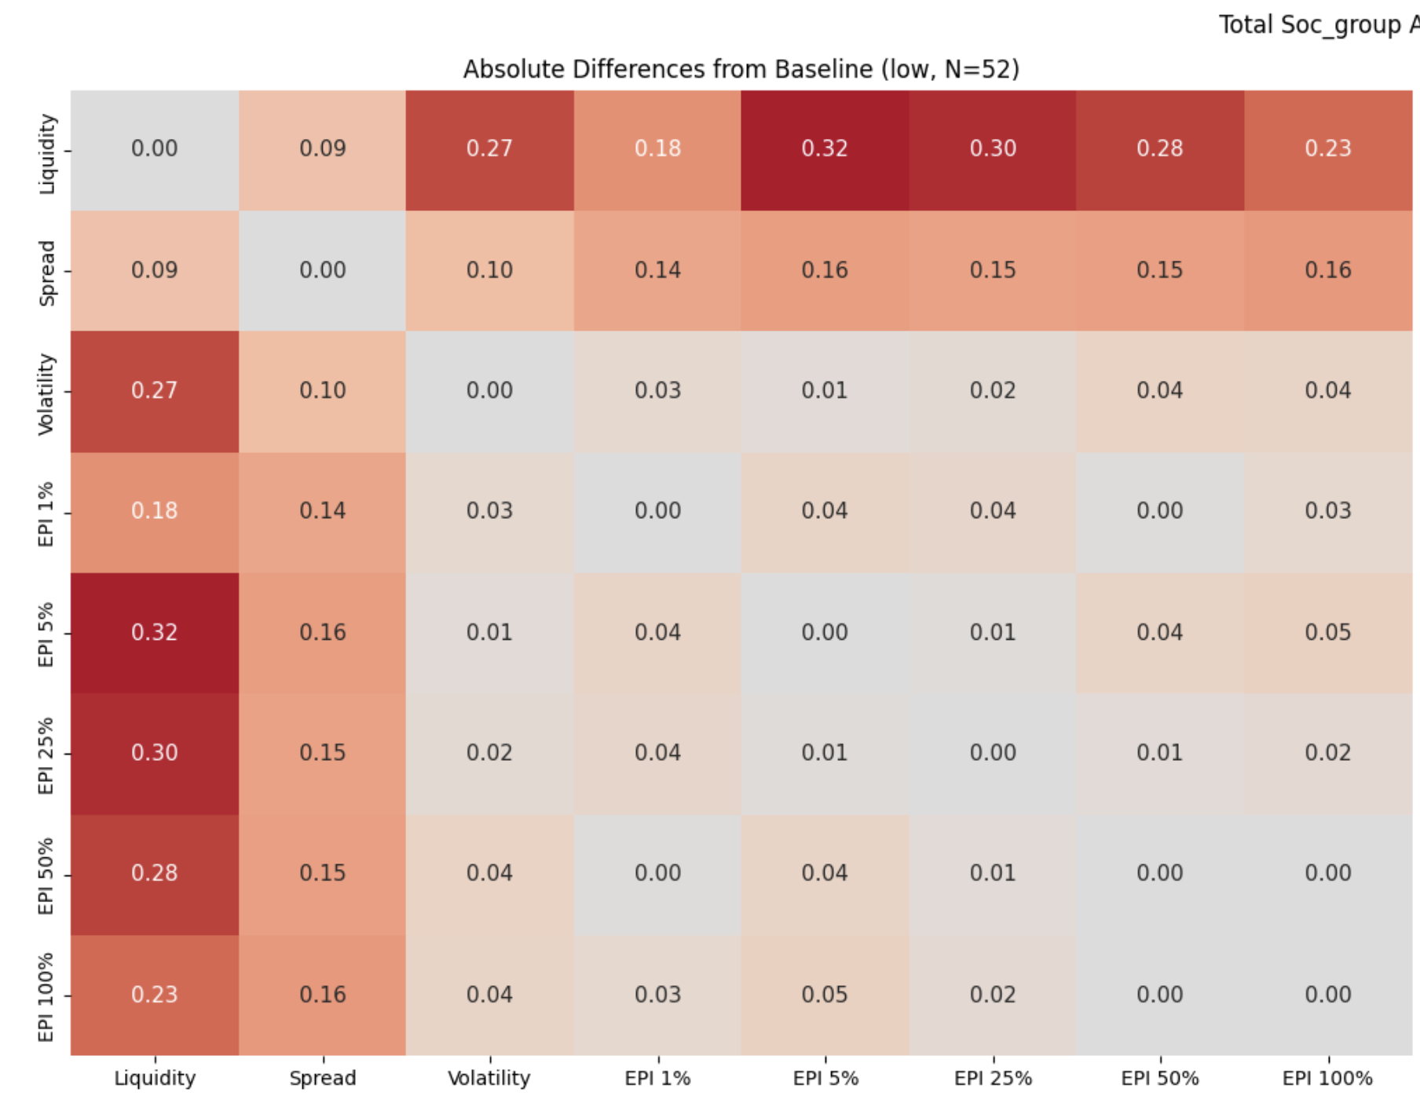
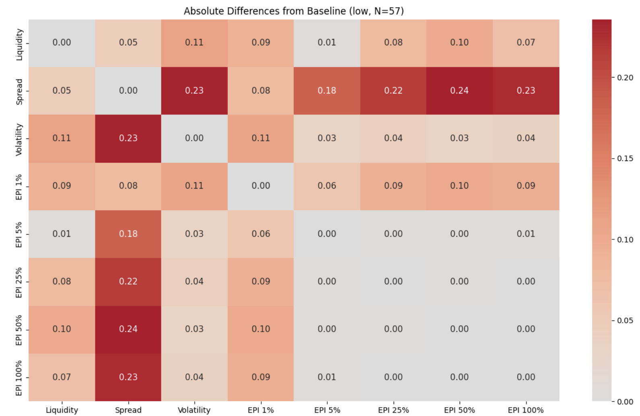
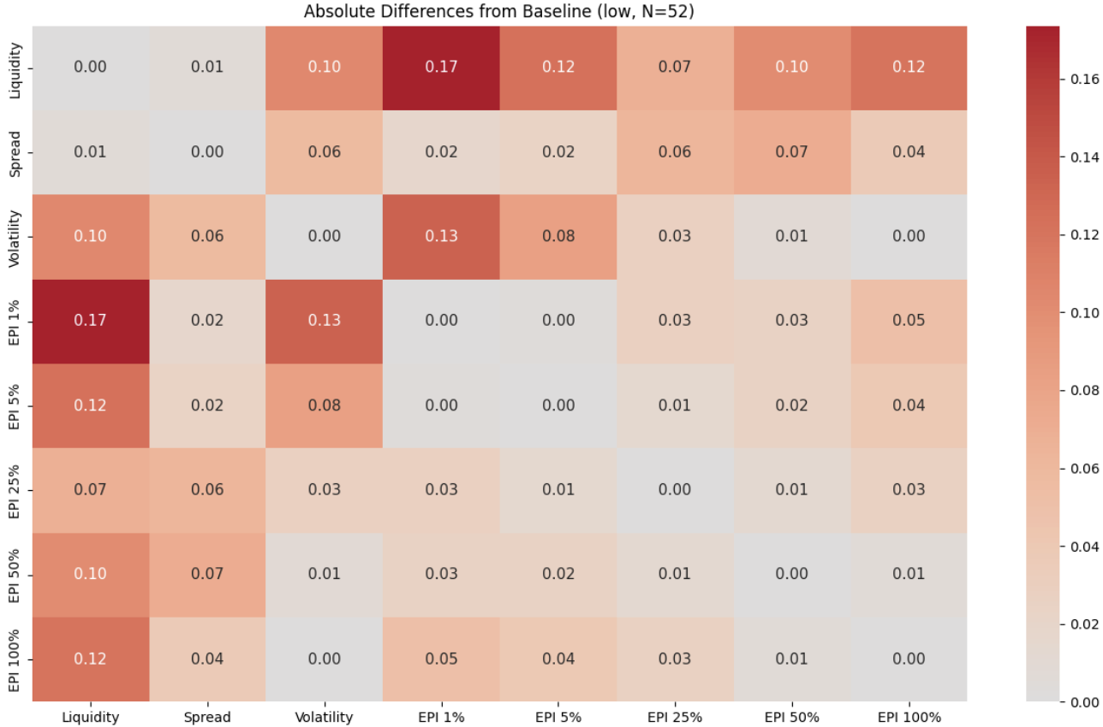
ESG Component Findings
Absolute Differences from Baseline of Correlation Between Trade Metrics and EPI For Total Dataset
High Social Score Strata
High Governance Score Strata
High Environmental Score Strata
Low Social Score Strata
Low Governance Score Strata
Low Environmental Score Strata
Low strata = 10th Percentile
High strata = 90th Percentile
Notes:
Rather than stratifying by the whole ESG Score this slide shows the stratification of the ESG components: social, governance and environmental using the ninetieth and tenth percentile
The dependent variables are the ACE Inputs of liquidity, spread and volatility. And the y axis shows the ACE model outputs.
As you can sort of tell with all of the red on the left..we saw Social has the biggest differences out of Environment and Governance

Slide 19
ESG Component Findings
Absolute Differences from Baseline of Correlation Between Liquidity and EPI Stratified By Social Score
High Social Score Strata
Low Social Score Strata
Low strata = 10th Percentile
High strata = 90th Percentile
Notes:
Zoning in on Social only, we see that the biggest difference is between Liquidity and the ACE model for both Low and High.
For the High Social stata on the left, we see that the relationship increases from 5% to 100%, scaling from .24 to .45 to high, and for Low social stata on right it decreases from 5% to 100%, scaling from .32 to .23.
We found both the strength of relationship and the inverse scaling to be interesting for further investigation

Slide 20
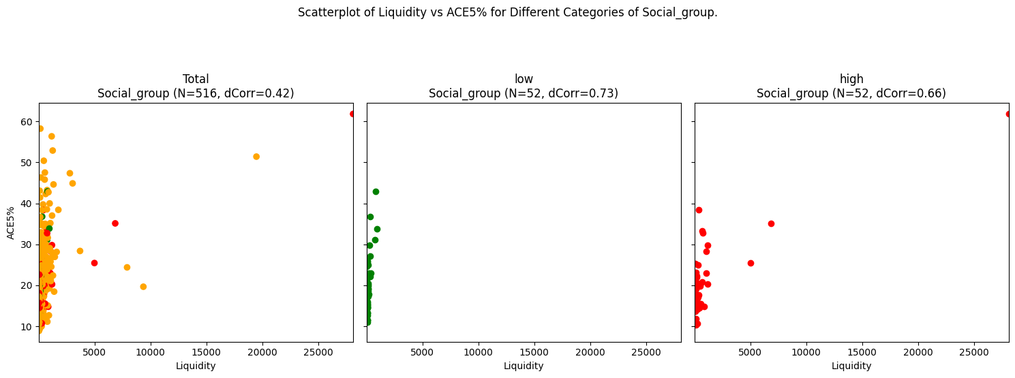
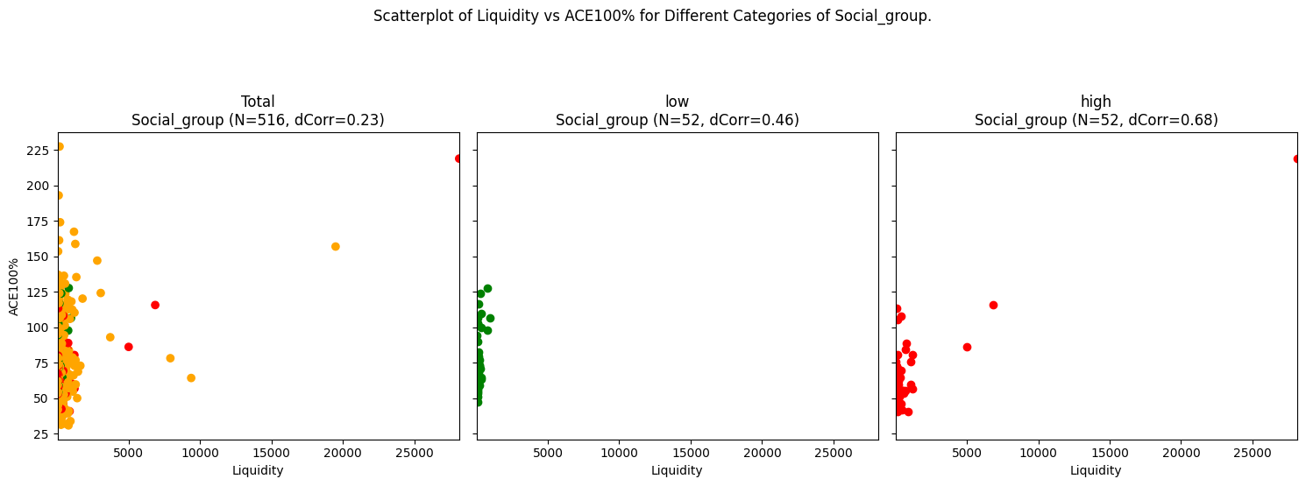
ESG Component Findings
High Social Score Strata
Low Social Score Strata
Notes:
Digging further and looking at the specific correlations and the scatter plots. Because we saw the trend from 5% to 100%, we decided to choose these two to compare.
For correlation, At both 5% and 100%, both Low and High increased from the baseline (all companies).
In prior stratifications we had noticed that if high increased, low decreased and vice versa. Here we are seeing that both increased.
Scatter plots show a slight difference in the population between green and red which is surprising given the trends we saw in correlation (highest to lowest and then lowest to highest)
Outliers: Tesla Biggest > 2nd biggest Nvidia
We think you might want to investigate these phenomena in your ACE model.
Now I will hand over to … who will take over the Controversy findings.

Slide 21
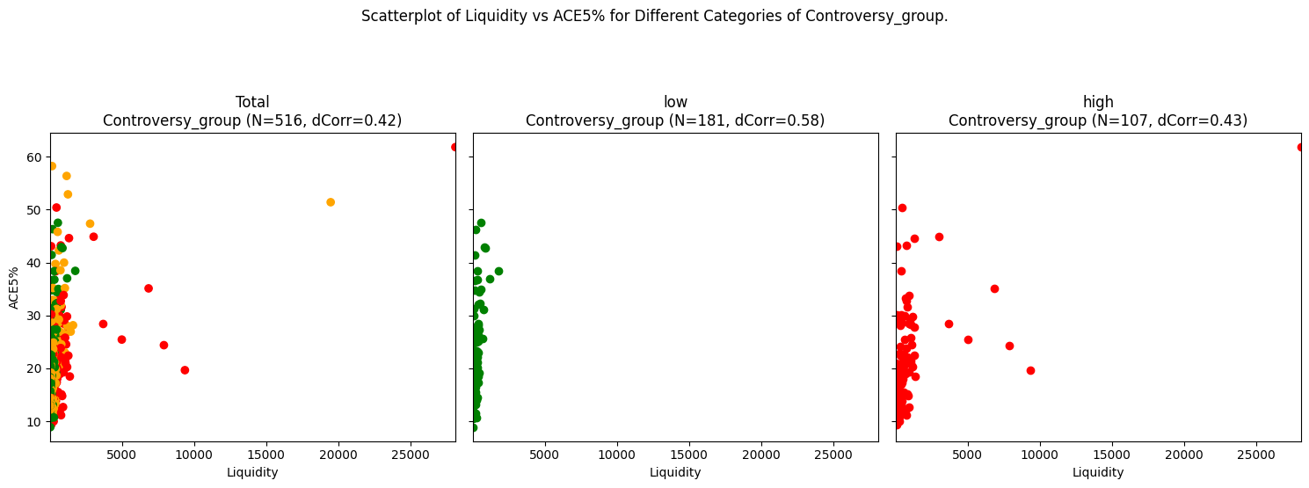
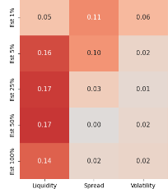
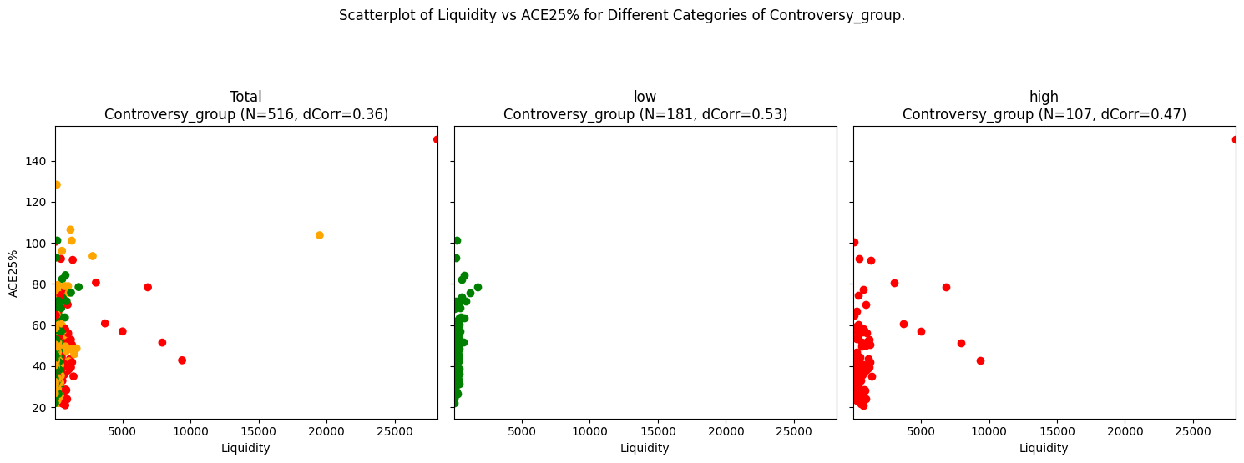
Controversy
Findings
Low Controversy Score Strata
Low Controversy strata = 0,1
High Controversy strata = 3,4,5
Notes:
Thank you Quinn.
Now I will walk u through our controversy score findings.
When we stratify securities using controversy score with values 0 & 1 under low controversy and 3,4,5 under high controversy,
We see the comparable biggest differences at low controversy shown on left chart for liquidity vs EST from 5% to 100% with ranges .16 to .14.
Now, why we chose liquidity here?
In the previous slide, when we looked at the first order effects, we saw liquidity was highest correlated at Est of 5% and 25%, so we will will focus on these relationships .
Now looking at The correlation, also shown here on scatter plot in first row , liquidity to 5% ACE in low controversy , we see it increases to .58 from a baseline of .42.
Similarly, The correlation liquidity to 25% ACE in low controversy shown here in 2nd row , it increases to .53 from a baseline of .36.(inc from .36 to .53)
Looking at scatter plots on first and second row, we see distribution in low is denoted by green and red for high for both at 5% and 25%.
On comparing the Plot for liquidity to both 5% and 25% , it shows that the distribution between high and low changes and it is very clear when comparing at green with the red distribution.
We don’t know why but it is worth looking into. For interest, the outlier here is TEsla denoted by red on scatter plot.
MOVING TO THE NEXT SLIDE

Slide 22
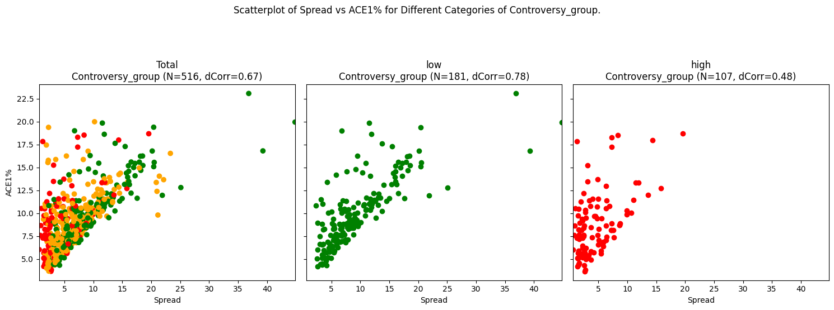
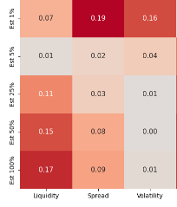
Controversy
Findings
High Controversy Score Strata
Notes:
Looking here at High Controversy we see our biggest difference aligns with your ACE model calculation of spread and Est 1%.
2. The difference shown here on left chart is 0.19 for spread vs 1% in high controversy
3. However, instead of increasing as the low strata does, the strength of relationship is decreasing when moving from total to high, ie from 0.67 corr to 0.48 corr value.
4. The scatter plots could indicate a difference in population between low and high. We see some effects with Controversy but with our limited visibility into the workings of your black box we cannot explain these effects.
Handing over to Tylor to walk through our conclusion.

Slide 23
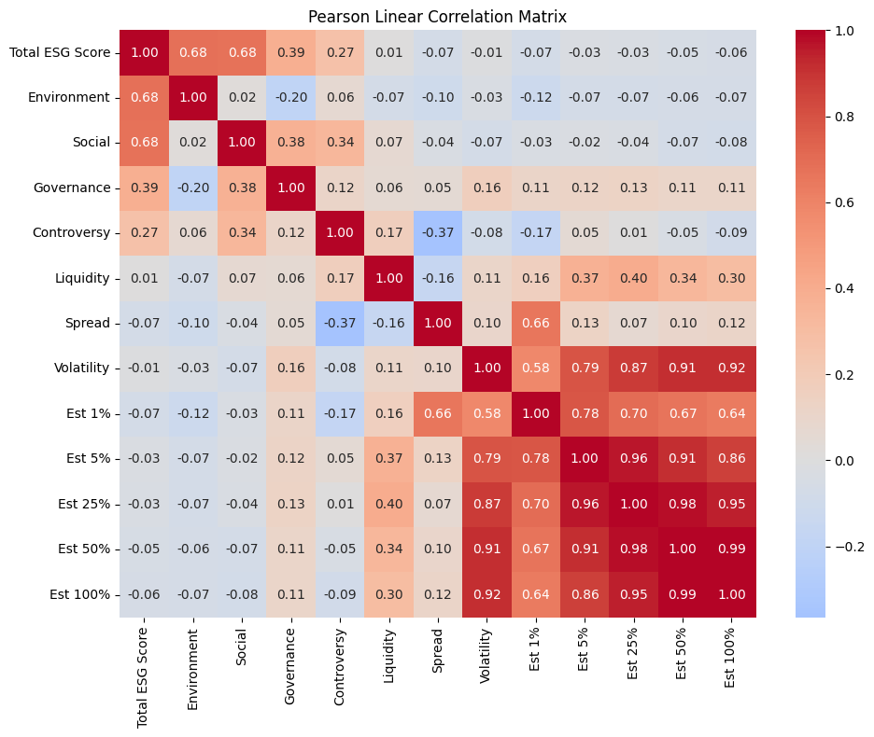
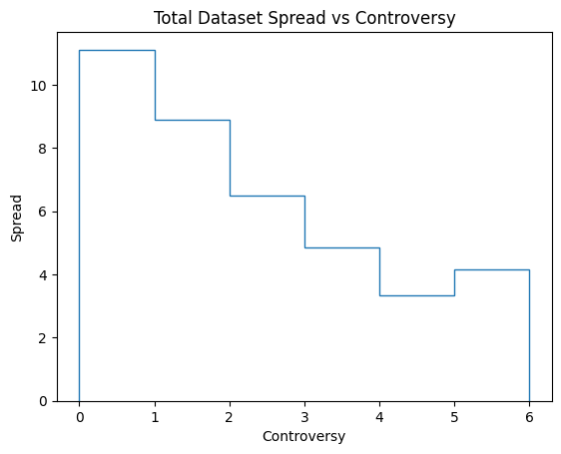
When we use Pearson to investigate the relationship between Controversy and Spread. A Pearson correlation shows the relationship is inverse: the higher the Controversy the lower the Spread. This would imply that higher the controversy surrounding a company the tighter the spread; the easier to trade. We were surprised by this!
Notes:
Pearson is a linear correlation statistic from -1 to +1. +1 is a strong linear relationship and -1 is a strong negative linear relationship.
Here we see a correlation of -.37 which means spread decreases when controversy increases.

Slide 24
Final Conclusion
We found no relationship between the ESG score and ACE
We found that there is no ESG component that has a direct correlation with ACE model output
Controversy is related to the trading metrics of spread and liquidity
We would not recommend you purchase the ESG data without further analysis
i. Explore how Social component of ESG affects your ACE model:
Liquidity with Estimated Price Impacts at 50 and 100%
ii. Explore how Controversy affects your ACE model:
Liquidity with Estimated Price Impact at 5% and 25%
Spread with Estimated Price Impact 1%
Notes:
Before we take any questions we would like to conclude

Slide 25
THANK YOU
Q&A
Notes:
Again Thank you for your time and thoughtful engagement. I hope this presentation has provided valuable insights and sparked meaningful discussions. Now we would be more than happy to address any question you might have. Thank you once again.

Slide 26

Solution & Benefits
Solution
Benefit
Use of TV screen over Black box to get visuality into Black box. It will take all tickers going in and out.
It wIll help us to look inside the black box and will enable us to see strength of relations between trade metrics and ACE output.
2. Stratification of Total ESG score and its components
2. Stratification is when we take a subset of the population with certain characteristics (e.g., high total ESG score only) to look for changes in strength of relationship.
3. This matrix will help to see Change in correlation Matrix reflected by TV screen chang
3. Absolute Difference Correlation Matrix

Slide 27
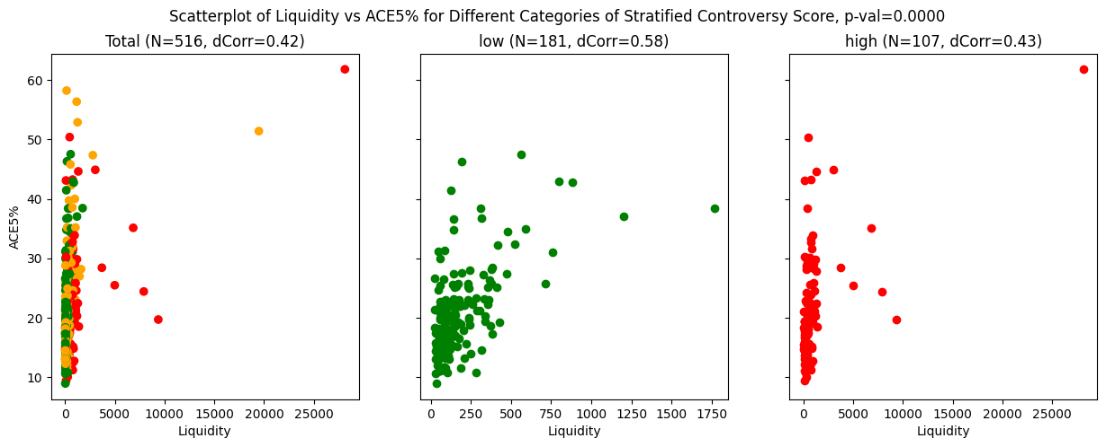
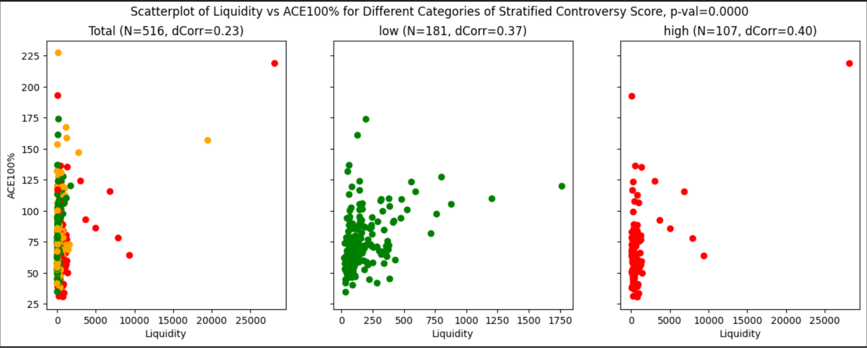
Controversy
Findings
Low Controversy Score Strata
Notes:
change scaling, distribution at 5% with total and distribution with 100%, r value is more in 5%, mention outliers ,u can see that

Slide 28
Further Evidence to support investigation into Controversy
Here we see in the first order effect, the relationship between Controversy and Spread. A Pearson correlation shows the relationship is inverse: the higher the Controversy the lower the Spread. This would imply that higher the controversy surrounding a company the tighter the spread, the easier to trade. We were surprised by this!

Slide 29
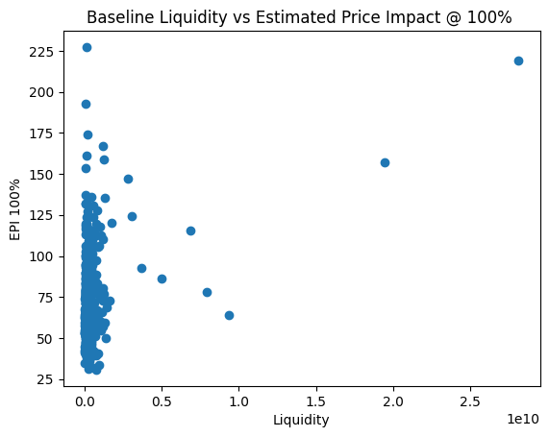
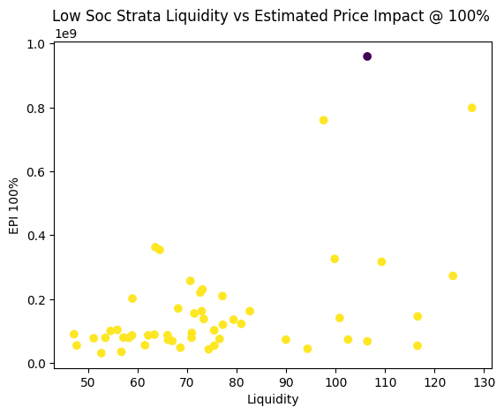
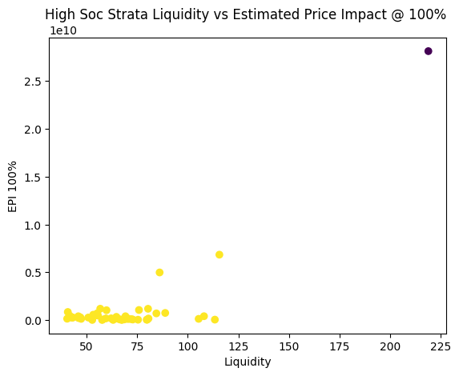
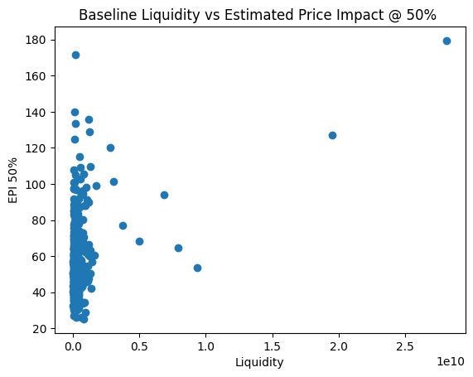
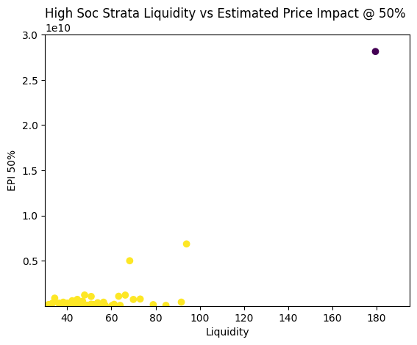
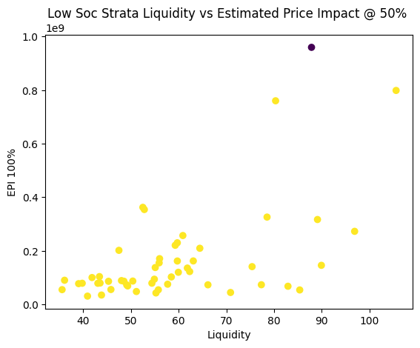
Other
Findings
Distance Correlation | 0.4639 | 0.6774
Distance Correlation | 0.5514 | 0.7052

Slide 30
Data Dictionary
Security
Grouping
Total ESG Score
Environment
Social
Governance
Controversy
21 day median daily value
5 day time weighted spread
60-Day Standard Deviation of Daily Returns
Estimated price impact for 1% MDV
Estimated price impact for 5% MDV
Estimated price impact for 25% MDV
Estimated price impact for 50% MDV
Estimated price impact for 100% MDV
Company’s Ticker
S&P or non S&P
Total ESG Score
Environment
Social
Governance
Controversy
Liquidity
Spread
Volatility
Est 1%
Est 5%
Est 25%
Est 50%
Est 100%
High score means High Risk
Components of Total ESG
Public perception of how a company manages controversy and incidents
Trading Metrics - input ACE Model
Estimated Price impact - output from ACE Model
Notes:
Make this prettier

Slide 31
Other
Findings
Distance Correlation | 0.4639 | 0.6774
Distance Correlation | 0.5514 | 0.7052

Slide 32
Methodology
Limitations and Challenges Of EDA Results
Case Study
VS
Limitation & Challenges
Limitation 1
01
Found No solution to our Case study as No relation was found between ESG and Trade Metrics.
How ESG effects Trade metrics & ACE Output.
01
Limitation 2
Non Visibility of Virtu Ace Model workings: Not aware of other factors Virtu ACE model algorithm uses while calculating EPI OR Ace Output.
02
Notes:
Case Study? Black box? New methodolgy? TV screen

Slide 33
ESG Component Findings
Absolute Differences from Baseline of Correlation Between Liquidity and EPI For Total Dataset
High Social Score Strata
High Governance Score Strata
High Environmental Score Strata
Low Social Score Strata
Low Governance Score Strata
Low Environmental Score Strata
Low strata = 10th Percentile
High strata = 90th Percentile
Notes:
First since there Looking at the heatmaps above we noticed that there's no significance with governance or environment. But when we look at high social scores at 50% and 100% EPI there are some outliers that required further analysis when comparing it to liquidity. There seems to have a scaling of going from low to high. There’s a bit of a increase in impact ranging from 1%-100%

Slide 34
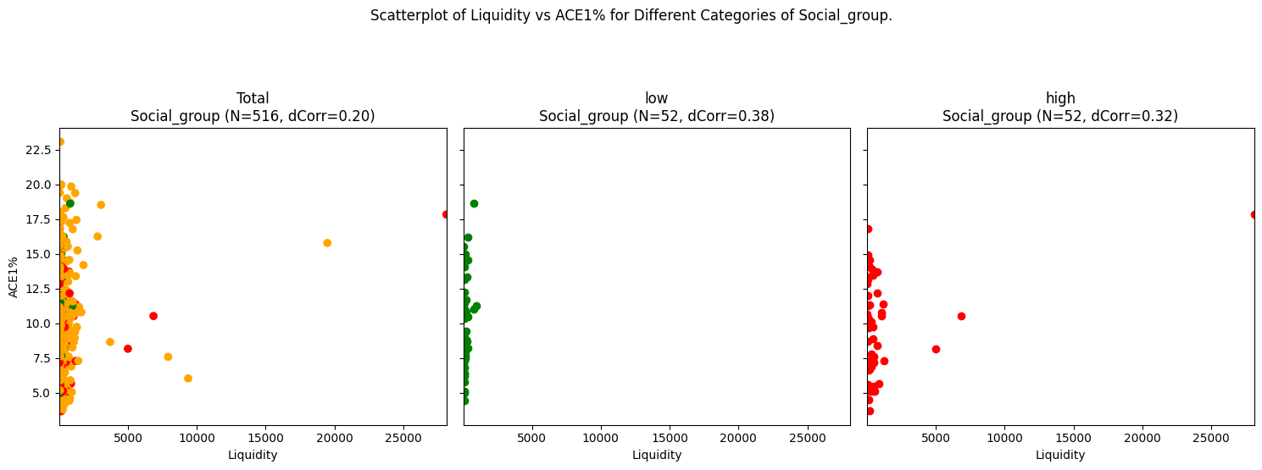

Slide 35
